Slide 1
Personal Fitness Lesson #3
Terminology (the what is he or she talking about)

Slide 2
The five components of fitness

Slide 3
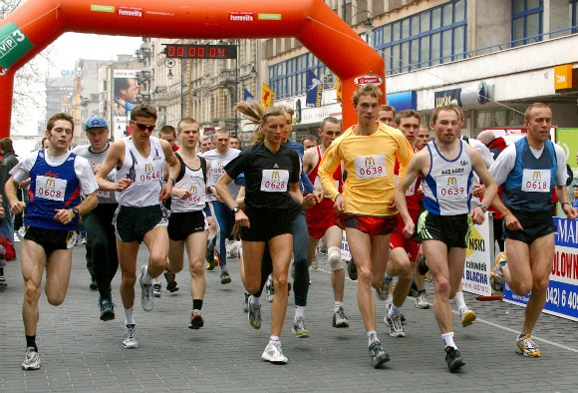
#1Cardiorespiratory Endurance
A term for someone’s aerobic fitness capacity; their ability to do prolonged exercise without fatigue.

Slide 4
Aerobic vs Anaerobic
Aerobic- with oxygen
Anaerobic- without oxygen
Aerobic fitness- reflects the amount of oxygen in the blood pumped by the heart and transported to the working muscles, as well as the muscles efficiency in using that oxygen. Aerobic training is at a lower intensity with the purpose of stimulating aerobic metabolism.
Examples of aerobic exercises include cardio machines, spinning, running, swimming, walking, hiking, aerobics classes, dancing, cross country skiing, and kickboxing.
Aerobic exercises can become anaerobic exercises if performed at a level of intensity that is too high.
Anaerobic exercise is short-lasting, high-intensity activity, where your body's demand for oxygen exceeds the oxygen supply available. Anaerobic exercise relies on energy sources that are stored in the muscles and, unlike aerobic exercise, is not dependent on oxygen from (breathing) the air.
Examples of anaerobic exercise include heavy weight training, sprinting (running or cycling) and jumping.

Slide 5
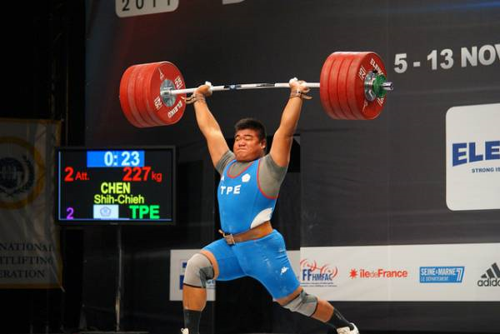
#2 Muscular Strength
The maximum amount of force that a muscle can exert against some form of resistance in a single effort.

Slide 6
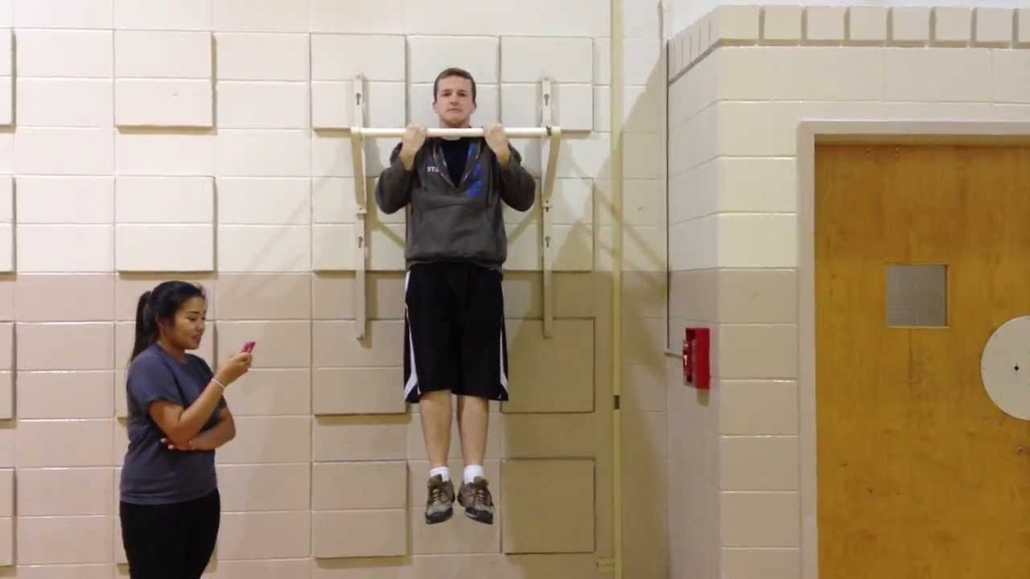
#3 Muscular Endurance
The ability of a muscle or group of muscles to sustain repeated contractions against a resistance for an extended period of time.

Slide 7
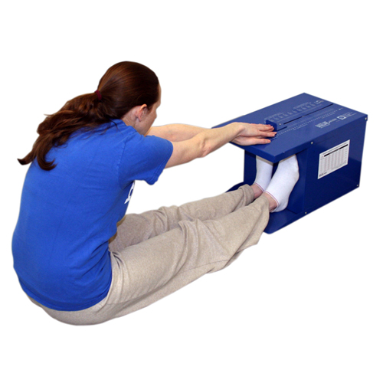
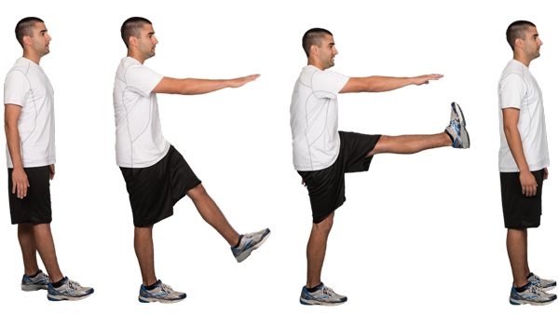
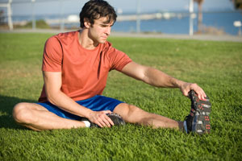
#4 Flexibility
The range of motion of your joints or the ability of your joints to move freely.
Better flexibility may improve your performance in physical activities or decrease your risk of injuries by helping your joints move through their full range of motion and enabling your muscles to work most effectively. Stretching also increases blood flow to the muscle.

Slide 8
Body Composition

Slide 9
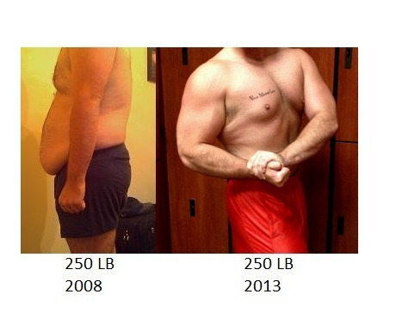
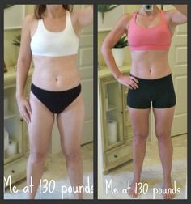
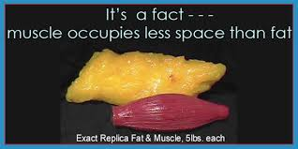
Why is Body composition a better indicator of health than just a scale??
Because your body is made up of two things: fat (essential fat + excess fat), and non-fat (muscle, bone, etc). Those two things combined are the number you know as weight. And weight does not always indicate health.
Muscle does not weigh more than fat, any more than lead weighs more than feathers. A pound is a pound is a pound. Where the misunderstanding often comes in is that muscle is much more dense than fat, so that, by volume, it seems to weigh more. That is, a pound of muscle occupies less space than a pound of fat.

Slide 10
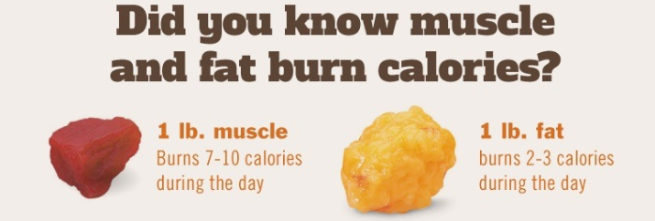
Benefits of increasing Muscle Mass
Weight Control- As far as metabolism goes, muscle mass is the "engine" of the calorie-burning machine. As you strength train and increase your muscle mass, you build a bigger, more efficient engine that burns more calories and helps you lose weight. The more toned your muscles, the easier it is to maintain your weight. In fact, the higher your muscle mass, the more calories you'll burn when you rest.
Increased Strength- Increasing your strength will help you lead a more active lifestyle infused with spontaneous activity.
Reduced Risk of Injury- Building muscle also helps protect your joints from injury.
Boost your self esteem- Strong, toned muscles also enhance your appearance and make you feel better overall.

Slide 11
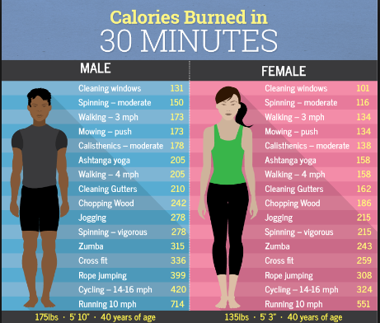
Are women “fattier than men?
YES- While it is obviously not true in all cases, women generally have a higher percentage of body fat than men.
Body fat content is 25% for women at normal size compared to 15% for men.
All other things being equal, such as age and exercise levels, women require fewer calories per pound of body weight daily than do men. Female hormones are another contributing factor.
In terms of losing weight:
Men tend to have more lean muscle tissue, which burns more calories than body fat, even during rest. And when men and women cut the same number of calories, men usually do lose more weight.

Slide 12
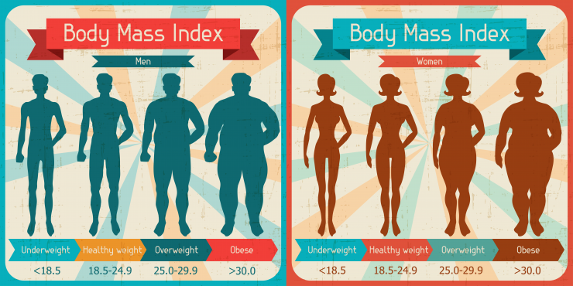
What is body mass index (bmi)?
Body Mass Index (BMI) is a person's weight in kilograms divided by the square of height in meters. A high BMI can be an indicator of high body fatness. BMI can be used to screen for weight categories that may lead to health problems, but it is not diagnostic of the body fatness or health of an individual.

Slide 13
Types of training to increase muscle and reduce fat
1. Circuit Training- A sequence of exercises performed one after the other with little rest in between.
2. Interval Training- A training session that involves repeated bouts of exercise separated by rest intervals.
3. Resistance Training- Training designed to increase the body’s strength, power, and muscular endurance through resistance training.

Slide 14
Circuit Training sample

Slide 15
Interval Training Sample

Slide 16
Resistance Training Sample

Slide 17
Conclusion
The five components of fitness are essential pieces to general health and wellness.
The number on the scale is not always the best indicator of health; knowing one’s body composition (what you are made of) is more important than anything else because a pound is a pound!
Knowing various ways to train to increase muscle and reduce fat are important when training.

